Slide 1

Systems of Linear Equations

Slide 2
Matrices
A matrix is a two-dimensional data structure where numbers are arranged into rows and columns.
A general matrix is given by:
^{𝑎}11 ^{⋯ 𝑎}1𝑚
⋮ ⋱ ⋮
^{𝑎}𝑛1 ^{⋯ 𝑎}𝑛𝑚
𝐴 =
Where 𝑛 is number of rows and 𝑚 is number of columns.
Matrices are very important data structures for many mathematical and scientific calculations.

Slide 3
Examples
Example of a 3 x 3 matrix:
1 5 3
6 6
3 8 9
𝐴 = 4
Example of a 4 x 2 matrix:
1 5
5
3 2
Example of a 3 x 4 matrix:
𝐴 = ⁴
1 5 3 4
5 7 8
7 8 9 3
7 8
𝐴 = 4

Slide 4
Vectors
A vector is a one-dimensional data structure where numbers are arranged into rows or columns.
𝑥₁
𝑥₂
A general vector is given by:
𝑥 =
⋮
^{𝑥}𝑛
Where n is number of rows and m is number of columns.
Matrices and vectors are very important data structures for many mathematical and scientific calculations.

Slide 5
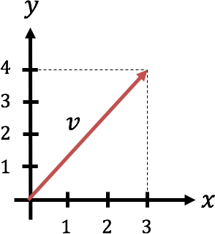
Vectors
Assume the vector 𝑥:
The Length of vector 𝑥 is given by:
𝑥₁
𝑥₂
⋮
𝑥_{𝑛}
𝑥 = 𝑥^{𝑇}𝑥 = 𝑥² + 𝑥² + ⋯ + 𝑥²
1 2 𝑛
The length of a vector most makes sense for 2 or 3 dimensional vectors.
𝑥 =
The Transpose of vector 𝑥 is
It can be visualized like this: Example:
𝑣 = 3, 4
𝑥^{𝑇} = ^{𝑥}1
𝑥₂ ⋯ 𝑥_{𝑛}
In order to find the length of 𝑣 we use Pythagoras like this:
𝑣 = 3² + 4² = 9 + 16 = 25 = 5

Slide 6



Standard Python
Python doesn't have a built-in type for matrices. However, we can treat list of a list as a matrix.
a = [1, 3, 7, 2]
print("a =", a)
A = [[1, 3, 7, 2],
[5, 8, -9, 0],
[6, -7, 11, 12]]
print("A =", A)
Example of a 3 x 4 matrix:
1 3 7 2
𝐴 = 5 8 −9 0
6 −7 11 12
1
3
7
2
Example of vector:
𝑎 =
So we can define vectors and matrices with standard Python, but standard Python has no support for manipulation and calculation of them.
But fortunately we can use the NumPy package for creating matrices and for matrix manipulation.

Slide 7
Linear algebra (numpy.linalg)
The NumPy library has a submodule for Linear Algebra, namely numpy.linalg
https://numpy.org/doc/stable/reference/routines.linalg.html
The SciPy library also contains a linalg submodule, and there is overlap in the functionality provided by the SciPy and NumPy submodules.
https://docs.scipy.org/doc/scipy/reference/linalg.html#module- scipy.linalg

Slide 8



numpy.array
Let's use the Array feature in the NumPy Library:
import numpy as np
a = np.array([[1],
[3],
[7],
[2]])
Example of a 3 x 4 matrix:
1 3 7 2
8 −9 0
6 −7 11 12
𝐴 = 5
print("a =", a)
A = np.array([[1, 3, 7, 2],
[5, 8, -9, 0],
[6, -7, 11, 12]])
Example of vector:
1
3
7
2
𝑎 =
print("A =", A)

Slide 9
Matrix Addition, Subtraction, Multiplication

Slide 10

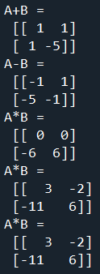
Matrix Addition, Subtraction, Multiplication
Matrix Addition, Subtraction, Multiplication
import numpy as np
A = np.array([[0, 1],[-2, -3]])
B = np.array([[1, 0],[3, -2]])
C = A + B
print("A+B =", C)
C = A - B
print("A-B =", C)
C = A * B
print("A*B =", C) # Not Working!, only elementwise Multiplication!
#Working Alternative 1
C = A.dot(B)
print("A*B =", C)
#Working Alternative 2
C = np.dot(A,B)
print("A*B =", C)
In this example we use numpy.array
Given the following matrices:
𝐴 =
0 1
−2 −3
1 0
3 −2
𝐵 =

Slide 11
Matrix Multiplication
In matrix multiplication the inner dimensions need to be same.
The size of the resulting matrix will be the outer dimensions.

Slide 12
Transpose of a Matrix

Slide 13
Transpose of a Matrix - Examples
1 5 6
1 3 7 2
8 −9 0
6 −7 11 12
𝐴 = 5
𝐴^{𝑇} =
3 | 8 | −7
7 | −9 | 11
2 | 0 | 12
1 5
5
3 2
7 8
4 3 7
5 5 2 8
𝐵 = ⁴
𝐵^{𝑇} = ¹

Slide 14



Transpose of a Matrix - Examples
import numpy as np
A = np.array([[1, 3, 7, 2],
[5, 8, -9, 0],
[6, -7, 11, 12]])
print("A="); print(A)
Atr = np.transpose(A)
print("Transpose of A="); print(Atr)
B = np.array([[1, 5], [4, 5],[3, 2],
[7, 8]])
print("B="); print(B)
Btr = np.transpose(B)
print("Transpose of B="); print(Btr)
[ | 3 | 8 | -7]
[ | 7 | -9 | 11]
[ | 2 | 0 | 12]]

Slide 15
Determinant of a Matrix
The Determinant of a matrix is a special number that can be calculated from square matrices.
What is the Determinant used for?
The determinant helps us find the inverse matrix
The Determinant will give us useful information when dealing with Systems of Linear Equations

Slide 16
Determinant of a Matrix

Slide 17
Determinant of a Matrix
For a 3𝑥3 matrix we have:
We develop the determinant along a row or a column.
^{𝑎}11
^{𝑎}12
^{𝑎}22
^{𝑎}32
^{𝑎}13
^{𝑎}23
^{𝑎}33
𝐴 = ^{𝑎}21
^{𝑎}31
𝑑𝑒𝑡 𝐴 = 𝐴 = 𝑎
^{𝑎}22
^{𝑎}32
^{𝑎}23
^{𝑎}33
− 𝑎
^{𝑎}12
^{𝑎}32
^{𝑎}13
^{𝑎}33
+ 𝑎
^{𝑎}12
^{𝑎}22
^{𝑎}13
^{𝑎}23
11
21
31
Here we have developed the determinant along the first column
We see that the determinant of a higher order system can be expressed as a sum of lower order determinants
It will be a little more complicated and time-consuming work for systems with larger order, so we need a programming language like python to handle this.

Slide 18
Determinant of a Matrix

Slide 19



Determinant of a Matrix
Given the following Matrices:
import numpy as np
import numpy.linalg as la
𝐴 = ¹
2
3 4
−1 3 0
2 1 −5
1 4 −2
𝐵 =
A = np.array([[1, 2],
[3, 4]])
Adet = la.det(A)
𝑑𝑒𝑡 𝐴 = −2
𝑑𝑒𝑡 𝐵
= −21
print(Adet)
Python Solution:
-2.0000000000000004
-21.00000000000001
B = | np.array([[-1, | 3, | 0],
 | [2, | 1, | -5],
 | [1, | 4, | -2]])
Bdet = la.det(B)
print(Bdet)

Slide 20
Inverse Matrices
It will be more complicated for systems with larger order, so we need a programming language like python to handle this.

Slide 21
Inverse Matrices
Given the following Matrices:
import numpy as np
import numpy.linalg as la
𝐴 = ¹
2
3 4
−1 3 0
2 1 −5
1 4 −2
𝐵 =
A = np.array([[1, 2],
[3, 4]])
Ainv = la.inv(A)
_{𝐴-1 =} −2 1
1.5 −0.5
𝐵⁻¹ =?
Python Solution:
[[-2. 1. ]
print(Adet)
B = | np.array([[-1, | 3, | 0],
 | [2, | 1, | -5],
 | [1, | 4, | -2]])
[ 1.5 -0.5]]
[[-0.85714286 | -0.28571429 | 0.71428571]
[ 0.04761905 | -0.0952381 | 0.23809524]
[-0.33333333 | -0.33333333 | 0.33333333]]
Binv = la.inv(B)
print(Binv)

Slide 22
Solving Linear Equations by
Phyton functions

Slide 23
Linear Equations
Given the following linear equations:
𝑎₁₁𝑥₁ + 𝑎₁₂𝑥₂ + 𝑎₁₃𝑥₃ + ⋯ = 𝑏₁
𝑎₂₁𝑥₁ + 𝑎₂₁𝑥₂ + 𝑎₂₃𝑥₃ + ⋯ = 𝑏₂
⋯
These equations can be set on the following general form:
𝐴𝑥 = 𝑏
Where A is a matrix, x is a vector with the unknowns and b
is a vector of constants
Solution:
𝑎
𝑥₁
𝑥₂
⋮
𝑥_{𝑛}
𝑏₁
𝑏₂
⋮
𝑏
𝑥 = 𝐴⁻¹𝑏
(assuming 𝐴⁻¹ is possible )
11 ^{⋯ 𝑎}1𝑚
⋮ ⋱ ⋮
⋯
𝐴 =
𝑥 =
𝑏 =
^{𝑎}𝑛1
^{𝑎}𝑛𝑚
𝑛

Slide 24
Example
Given the following linear equations:
𝑥₁ + 2𝑥₂ = 5 3𝑥₁ + 4𝑥₂ = 6
We want to put the equations on the following general form:
𝐴𝑥 = 𝑏
This gives:
The solution is given by:
𝑥 = 𝐴⁻¹𝑏
1 2
3 4
5
𝑥₁
𝐴 =
𝑏 = ₆
𝑥 = _{𝑥2}

Slide 25




Example - Python
Python code:
This gives the following solution:
[[-4. ]
[ 4.5]]
This means:
𝑥₁ = −4
𝑥₂ = 4.5
import numpy as np
import numpy.linalg as la
A = np.array([[1, 2],
[3, 4]])
b = np.array([[5],
[6]])
Ainv = la.inv(A) x = Ainv.dot(b) print(x)
Note! The A matrix must be square and of full- rank, i.e. the inverse matrix needs to exists.

Slide 26



Example – Python (Alt2)
We can also use the linalg.solve()function
x = np.linalg.solve(A, b)
Python code:
import numpy as np
This gives the following solution:
[[-4. ]
[ 4.5]]
This means:
A = np.array([[1, 2],
[3, 4]])
𝑥₁ = −4
𝑥₂ = 4.5
b = np.array([[5],
[6]])
Which is the same as the solutions we got from the other methods
x = np.linalg.solve(A, b)
print(x)
Note! The A matrix must be square and of full- rank, i.e. the inverse matrix needs to exists.

Slide 27
Inverse of a matrix
One way to determine if a matrix is singular is by computing its determinant. If the determinant is 0, then the matrix is singular; if not, the matrix is non-singular.
If a the matrix is singular, it has no inverse.

Slide 28
ill-conditioned matrix
A matrix that is close to being singular (i.e., the determinant is close to zero) is called illconditioned.
Although ill-conditioned matrices have inverses, they are problematic numerically in the same way that dividing a number by a very, very small number is problematic.
That is, it can result in computations that result in overflow, underflow, or numbers small enough to result in significant round-off errors.
The condition number is a measure of how ill-conditioned a matrix is: it is defined as the norm of the matrix times the norm of the inverse of the matrix.
In Python, it can be computed using NumPy’s function cond from linalg. The higher the condition number, the closer the matrix to being singular.

Slide 29
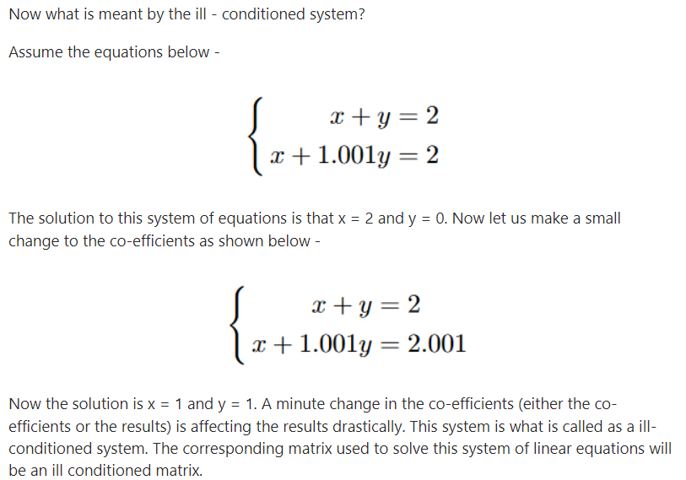
ill-conditioned matrix

Slide 30
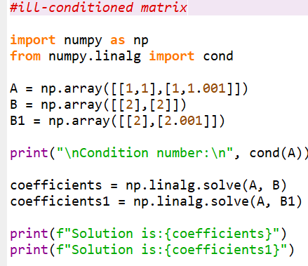
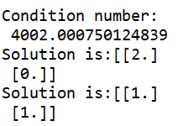
ill-conditioned matrix

Slide 31
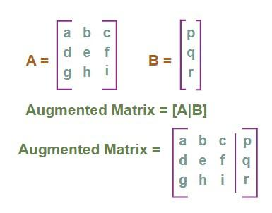
Solvability condition
Let A be an m × n matrix.
The rank of A is the maximal number of linearly independent row vectors.
Given the linear system Ax = B and the augmented matrix is (A|B).
If rank(A) = rank(A|B) = the number of rows in x
then the system has a unique solution.
If rank(A) = rank(A|B) < the number of rows in x
then the system has infinite number of solutions.
If rank(A) < rank(A|B)
then the system is inconsistent.
If rank(A)+1 = rank(A|B)
There is no solution. “B” is linearly independent of the columns of “A”.

Slide 32
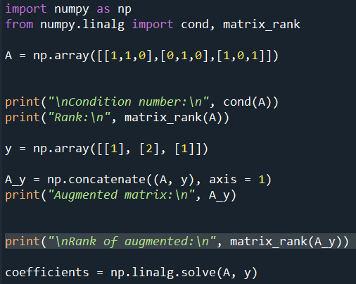
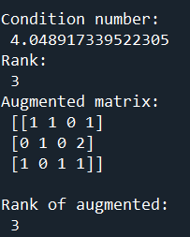
Sample Code

Slide 33




Python Example – Least Square
Python code:
Given the following linear equations:
𝑥₁ + 2𝑥₂ = 5 3𝑥₁ + 4𝑥₂ = 6
7𝑥₁ + 8𝑥₂ = 9
𝐴𝑥 = 𝑏
The results becomes:
[[-3.5 ]
[ 4.17857143]]
import numpy as np
A = np.array([[1, 2],
[3, 4],
[7, 8]])
b = np.array([[5],
[6],
[9]])
x = np.linalg.lstsq(A, b, rcond=None)[0]
print(x)
Note! In this example the
𝐴 matrix is not quadratic,
and the inverse of 𝐴 does
not exist! We need to use
another method, e.g., the
Least Square Method
(LSM)

Slide 34
Solving Linear Equations by
Gaussian Elimination

Slide 35
Solving Systems
An augmented matrix is a matrix made up of two smaller matrices separated by a vertical line.
Equations
Augmented Matrix

Slide 36
Solving Systems
To solve a system of equations using matrices, rewrite the augmented matrix in triangular form,
Augmented Matrix
Triangular Form
where a, p, and q are any constants.
From this matrix we can write an equivalent system of equations and use substitution to find the solution.

Slide 37
Solving Systems
Example:
Triangular Form
System of Equations
The system above can be easily solved by substitution.
The solution is (-6, 5).
Row transformations are used to rewrite an augmented matrix into triangular form.

Slide 38
Row Transformations
Procedures for Row Transformations
All the numbers in a row may be multiplied (or divided) by any nonzero real number. (This is the same as multiplying both sides of an equation by any nonzero real number.)
All the numbers in a row may be multiplied by any nonzero real number. These products may then be added to the corresponding in any other row. (This is equivalent to eliminating a variable from a system of equations using the addition method.)
The order of the rows may be switched. (This is equivalent to switching the order of the equations in a system of equations.)

Slide 39
Solving Systems
Example:
Solve the system by using matrices.
Rewrite the system as an augmented matrix.
Remember that we are trying to get the final matrix in triangular form:
We begin by using row transformation procedure 1 to replace the 2 in the first column, first row, with 1. To do so, we multiply the first row of numbers by ½ (1/2 R₁).

Slide 40
Solving Systems
or
1
We next use the row transformations to produce a 0 in the first column, second row where currently a 3 is in this position. We will multiply the elements in row 1 by -3 and add the products to row
The elements in the first row multiplied by -3 are:
-3(1) -3(2) -3(-1)
or
-3 -6 3

Slide 41
Solving Systems
Now add these products to their respective elements in the second row to get
or
1
2
We next use row transformation to produce a 1 in the second row, second column where currently a -8 is in this position. We do this by multiplying the second row by -1/8.
or
2

Slide 42
Solving Systems
The matrix is now in row echelon form and the equivalent system of equations is
x + 2y = -1
y = -1
Now we can solve for x using substitution
A check will show that (1, -1) is the solution to the original system.

Slide 43
Three Variables
To solve a system of three linear equations in three variables, we use the same row transformation procedures used when solving a system of two linear equations. Our goal is to produce an augmented matrix in the row echelon form
where a, b, c, p, q, and r represent numbers. This matrix represents the following system of equations.

Slide 44
Recognize Inconsistent and Dependent Systems
When solving a system of two equations, if you obtain an augmented matrix in which one row of numbers on the lift side of the vertical line is all zeros but a zero does not appear in the same row on the right side of the vertical line, the system is inconsistent and has no solution.
Inconsistent System

Slide 45
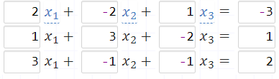
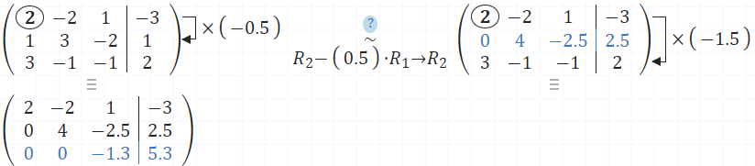
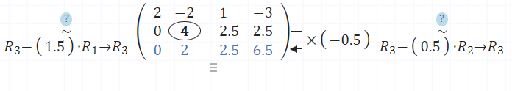
Example

Slide 46
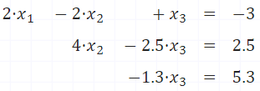



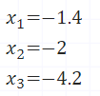
Back-substitution

Slide 47
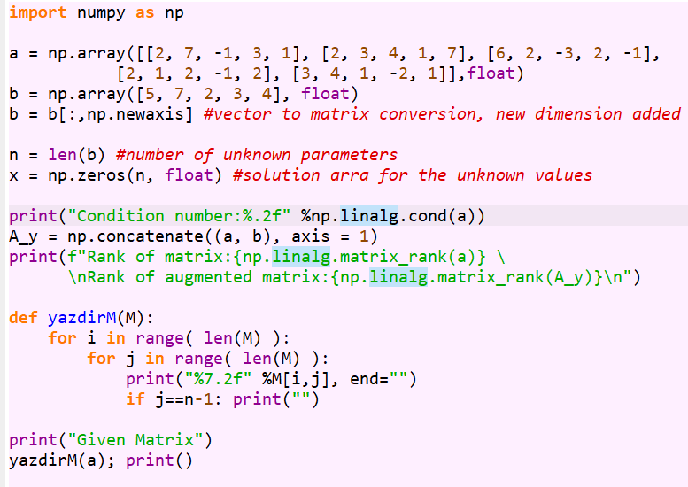
Example Code

Slide 48
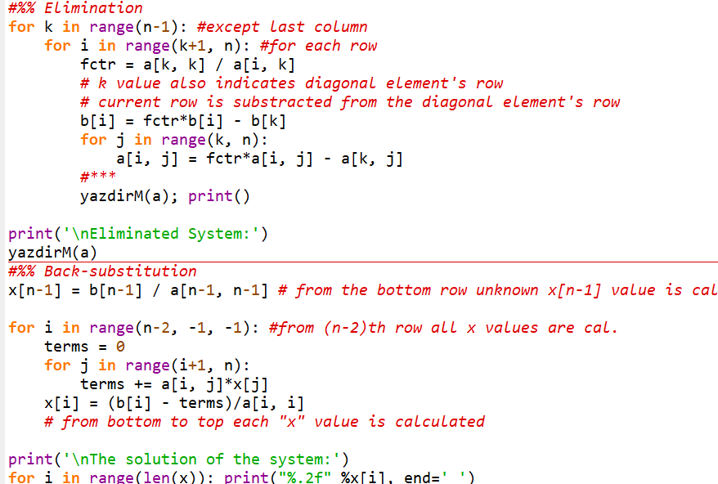
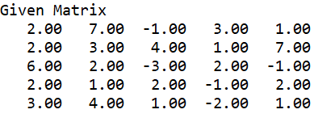
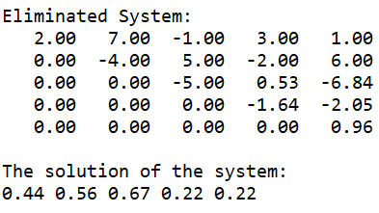
Example Code

Slide 49
Iteration Methods
Jacobi and Gauss-Seidel Methods

Slide 50
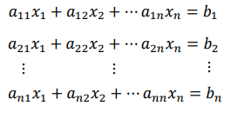
Jacobian method
Jacobian method or Jacobi method is one the iterative methods for approximating the solution of a system of n linear equations in n variables.
The Jacobi iterative method is considered as an iterative algorithm which is used for determining the solutions for the system of linear equations.

Slide 51
Jacobian method
This method makes two assumptions:
Assumption 1: The given system of equations has a unique solution.
Assumption 2: The coefficient matrix A has no zeros on its main diagonal, namely, a11, a22,…, a_{nn}, are non-zeros
If any of the diagonal entries a11, a22,…, a_{nn} are zero, then we should interchange the rows or columns to obtain a coefficient matrix that has nonzero entries on the main diagonal.

Slide 52




In this section we describe the Jacobi and the Gauss-Seidel iterative methods
We want to solve the following linear system
10 -1 2 0
-1 11 -1 3
2 -1 10 -1
0 3 -1 8
$$Ax=b$$
$$A$$
$$x$$
$$b$$
Example
solve the linear system

Slide 53
We want to solve the following linear system
Example
solve the linear system
Keep the diagonal on the left hand side
Jacobi Iterative Method
From the initial approx. $x^{(0)}=(0,0,0,0)^{T}$ we $x^{(1)}$
Change the coeff of LHS to be one by division

Slide 54

From the initial approx. $x^{(0)}=(0,0,0,0)^{T}$ we $x^{(1)}$
Jacobi Iterative Method
From the k-th approx. $x^{(1)}=(0.6,2.272,−1.1,−1.875)^{T}$ we $x^{(k+1)}$

Slide 55
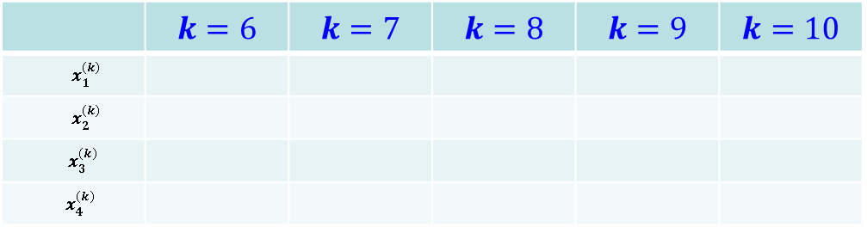
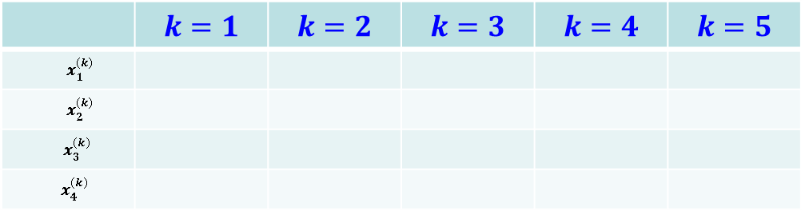
Jacobi Iterative Method
 | $$k=1$$ | $$k=2$$ | $$k=3$$ | $$k=4$$ | $$k=5$$
$$x_{1}^{(k)}$$
$$x_{2}^{(k)}$$
$x_{3}^{(k)}$
$x_{4}^{(k)}$
0.6000 1.0473 0.9326 1.0152 0.9890
2.2727 1.7159 2.0533 1.9537 2.0114
-1.1000 -0.8052 -1.0493 -0.9681 -1.0103
1.8750 0.8852 1.1309 0.9738 1.0214
 | $$k=6$$ | $$k=7$$ | $$k=8$$ | $$k=9$$ | $$k=10$$
$$x_{1}^{(k)}$$
$$x_{2}^{(k)}$$
$x_{3}^{(k)}$
$x_{4}^{(k)}$
1.0032 0.9981 1.0006 0.9997 1.0001
1.9922 2.0023 1.9987 2.0004 1.9998
-0.9945 -1.0020 -0.9990 -1.0004 -0.9998
0.9944 1.0036 0.9989 1.0006 0.9998

Slide 56
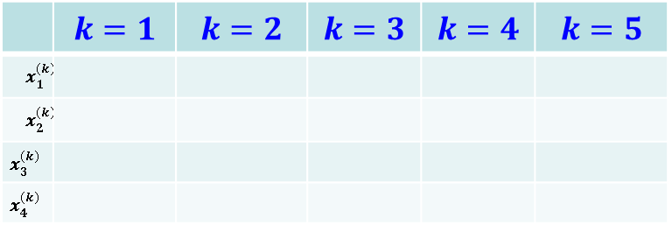
Gauss Seidel Method
From the k-th approx. $x^{(k)}=(0,0,0,0)^{T}$ we $x^{(k+1)}$
Note that in the Jacobi iteration one does not use the most recently available information.
From the k-th approx. $x^{(k)}=(0,0,0,0)^{T}$ we $x^{(k+1)}$
Gauss Seidel Method Iterations
 | $$k=1$$ | $$k=2$$ | $$k=3$$ | $$k=4$$ | $$k=5$$
$$x_{1}^{(k)}$$
$$x_{2}^{(k)}$$
$$x_{3}^{(k)}$$
$$x_{4}^{(k)}$$
Note that Jacobi’s method in this example required twice as many iterations for the same accuracy.
0.6000 1.0302 1.0066 1.0009 1.0001
2.3273 2.0369 2.0036 2.0003 2.0000
-0.9873 -1.0145 -1.0025 -1.0003 -1.0000
0.8789 0.9843 0.9984 0.9998 1.0000

Slide 57
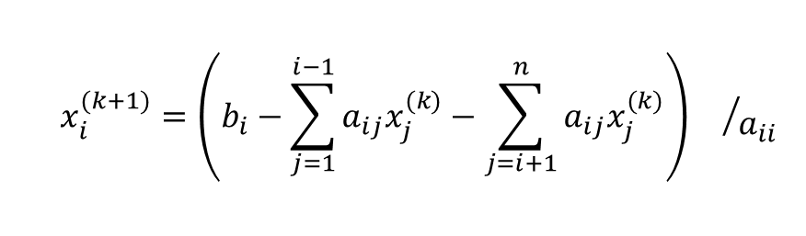
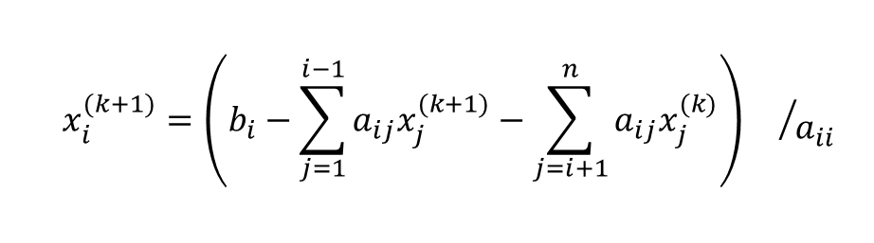
Jacobi iteration for general n:
$$x_{i}^{(k+1)}=\left(b_{i}−\sum_{j=1}^{i−1}{a_{ij}x_{j}^{(k)}}−\sum_{j=i+1}^{n}{a_{ij}x_{j}^{(k)}}\right){}/{a_{ii}}$$
Gauss-Seidel iteration for general n:
$$x_{i}^{(k+1)}=\left(b_{i}−\sum_{j=1}^{i−1}{a_{ij}x_{j}^{(k+1)}}−\sum_{j=i+1}^{n}{a_{ij}x_{j}^{(k)}}\right){}/{a_{ii}}$$

Slide 58
Jacobi iteration

Slide 59
Matrix definition for Jacobi method
A can be written as A=L+D+U (not decomposition)
Ax=b ⇒ (L+D+U)x=b
Dx^{k+1} =b-(L+U)x^{k}
x^{k+1}=D⁻¹b-D⁻¹(L+U)x^{k}
E=-D⁻¹(L+U)
f=D⁻¹b
x^{k+1}=f – E x^{k}
Dx^{k+1}

Slide 60
Gauss-Seidel (GS) iteration
Use the latest
update

Slide 61
x^{(k+1)}=Ex^{(k)}+f iteration for Gauss-Seidel
Ax=b ⇒ (L+D+U)x=b
(D+L)x^{k+1} =b -Ux^{k}
Dx^{k+1}
x^{k+1}=(D+L)⁻¹b - (D+L)⁻¹Ux^{k}
E=-(D+L)⁻¹U
f= (D+L)⁻¹b

Slide 62
Comparison
Gauss-Seidel iteration converges more rapidly than the Jacobi iteration since it uses the latest updates
But there are some cases that Jacobi iteration does converge but Gauss-Seidel does not

Slide 63

Convergence Criterion for the Gauss-Seidel and Jacobi Methods
Definition
A is strictly diagonally dominant
That is, the diagonal coefficient in each of the equations must be larger than the sum of the absolute values of the other coefficients in the equation
$${|a}_{ii}|>\sum_{\begin{aligned}j=1 \\ j≠i\end{aligned}}^{n}{\left|a_{ij}\right|, for all i}$$
Example1
Example2
10 -1 2 0
-1 11 -1 3
2 -1 10 -1
0 3 -1 8
10 -1 2 0
-1 4 -1 3
2 -1 4 -1
0 3 -1 2
THM:
A is strictly diagonally dominant

Slide 64
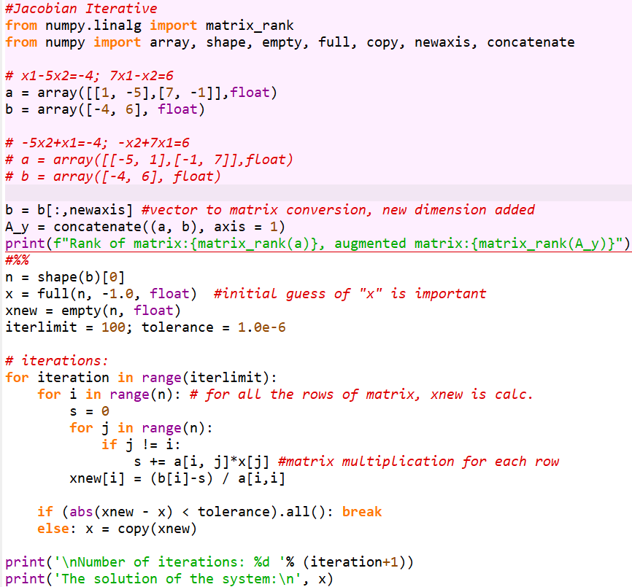

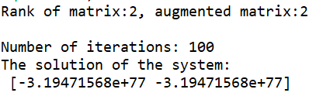
Code

Slide 65
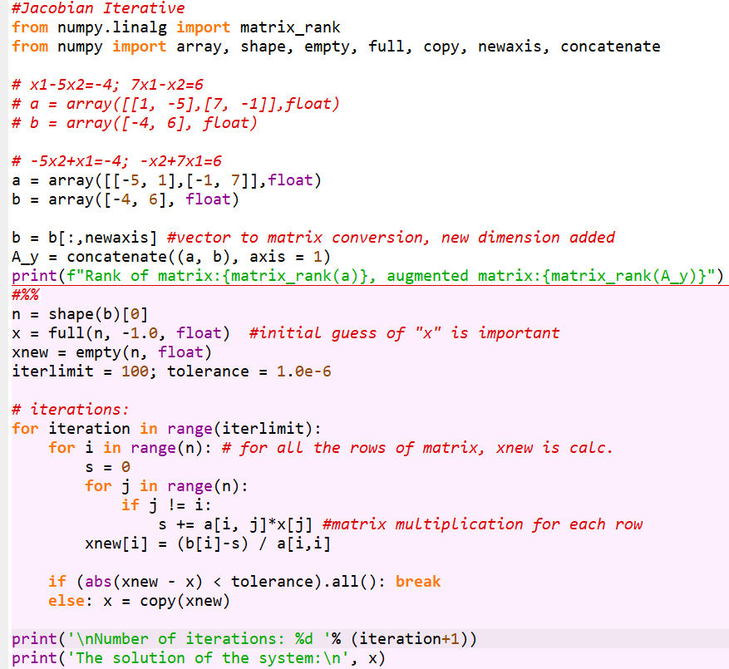
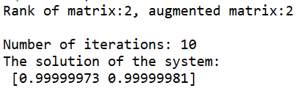
Code

Slide 66
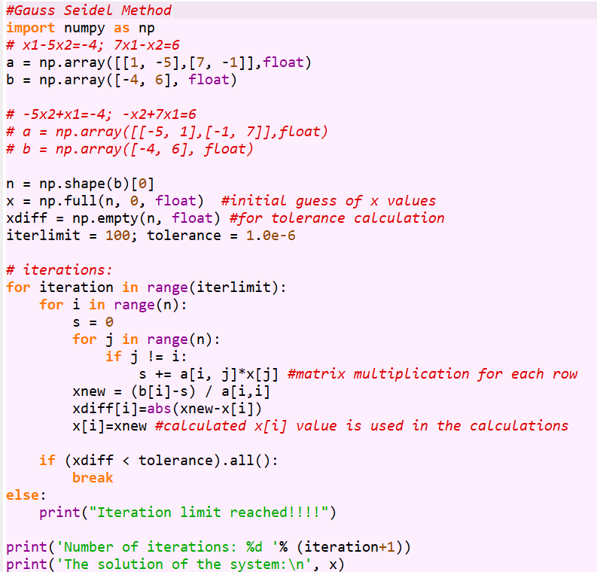
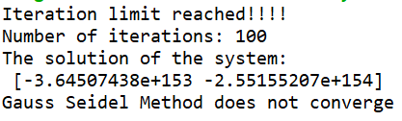
Code
s

Slide 67
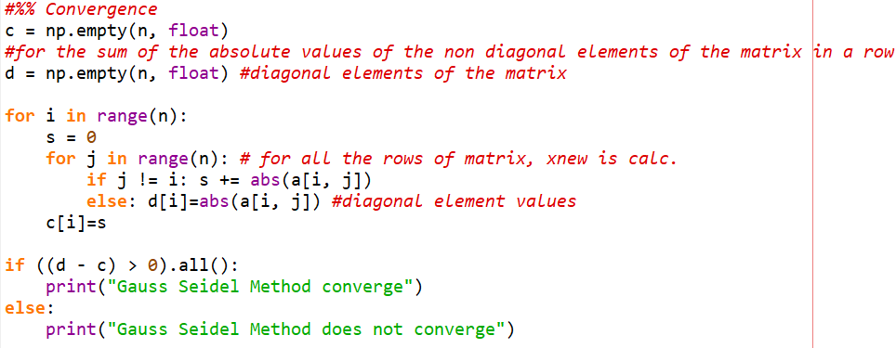

Slide 68
Error Definitions – True Error
Can be computed if the true value is known:

Slide 69
Error Definitions – Estimated Error
When the true value is not known:

